Slide 1

Small Cap Cryptos
Christine Nashashibi
Ameira Khaleq
Jeff Brinker
Justin Leffew

Slide 2
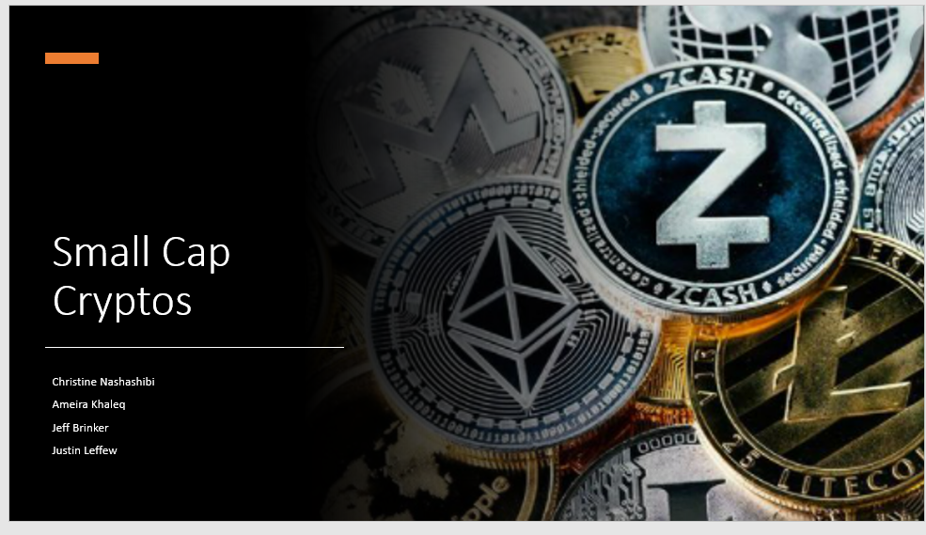
Motivation & Summary
Motivations
We wanted to see whether a portfolio or individual selection of a small bucket of lower market cap cryptocurrencies performed better, worse, or same as a more traditional crypto portfolio of Bitcoin and Ethereum.
Questions
Would picking a token with a small market cap outperform Bitcoin and Ethereum on a risk-adjusted basis over a 1-year timeframe?
Is picking one of these smaller tokens akin to buying a lottery ticket or could it be a solid investment?
Would it be better to randomly pick any token with a market cap under $1 billion or to take a portfolio of many?
Summary of Findings
While we were cut short on time to compute and analyze everything we wanted, we did get a good chunk of data. This data confirms that Bitcoin and Ethereum are the lowest risk of the selection of tokens we sampled, but also have the lowest potential returns.
Daily returns of Bitcoin and Ethereum are muted compared to the other tokens we selected, as were the standard deviations.
Monte Carlo Simulation returned data seems too good to be true due to sample size and dates

Slide 3
Questions & Data
Would picking a token with a small market cap outperform Bitcoin and Ethereum on a risk-adjusted basis over a 1-year timeframe?
To do this, first we had to select a random number of crypto tokens. We randomly chose some under $1 billion in total market capitalization, with most under $500 million. We then compared the previous one year returns to that of Bitcoin and Ethereum, as well as running a monte carlo simulation to determine potential future returns.
Is picking one of these smaller tokens akin to buying a lottery ticket or could it be a solid investment?
Probably more like a lottery ticket. Our data is not robust enough in that we only have roughly 1 year of data, which happened to take place during a major bull market for alt coins. Picking almost any of these would have generated better returns than investing in Bitcoin or Ethereum during the same timespan.
We did not have time to get into the random token returns vs multiple token returns but given the high standard deviations of these tokens, logically it would be a much safer bet to buy a small amount of many lower cap tokens than a large amount of any single one.

Slide 4
Data Cleanup & Exploration
We used CoinGecko’s API to pull data in, then transferred to a csv to save compute power and time. CoinGecko used Unix time, which required some adjustments to get to a proper datetime format.
While running the data, we had a few tokens that ended up giving us problems when trying to combine all data into a readable chart. We ended up dropping a few tokens that were giving us this issue, which enabled us to read clean data.
Data kept giving us NaN values when running MCSimulation and some of the values were such outliers that we couldn’t properly chart our data. To solve this, we ended up omitting the outlier data.
To analyze the data, we ran it through a variety of methods. Sharpe Ratio, cumulative returns, standard deviations, correlations with other cryptos, and ran a Monte Carlo Simulation

Slide 5
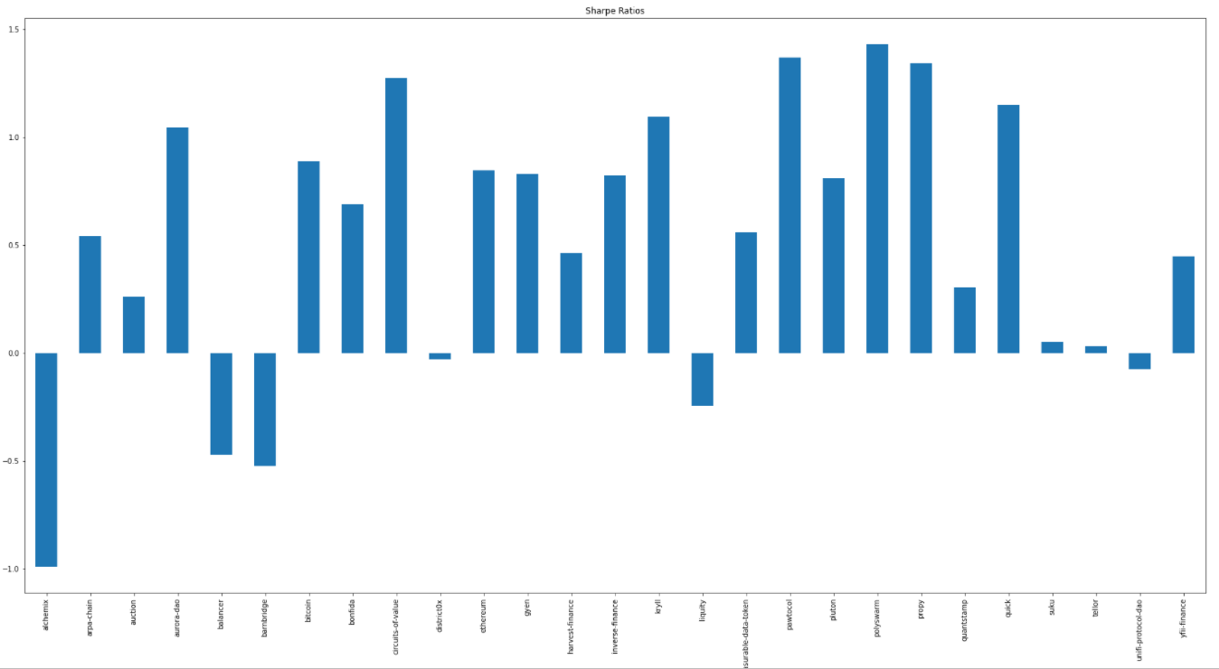
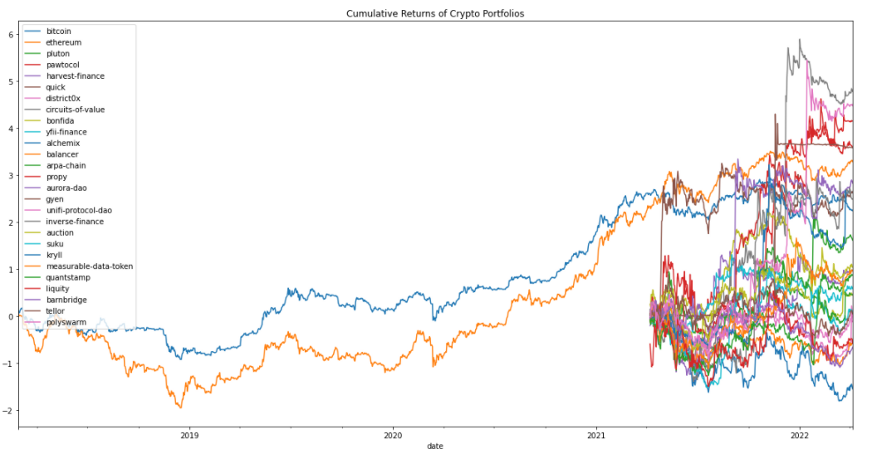
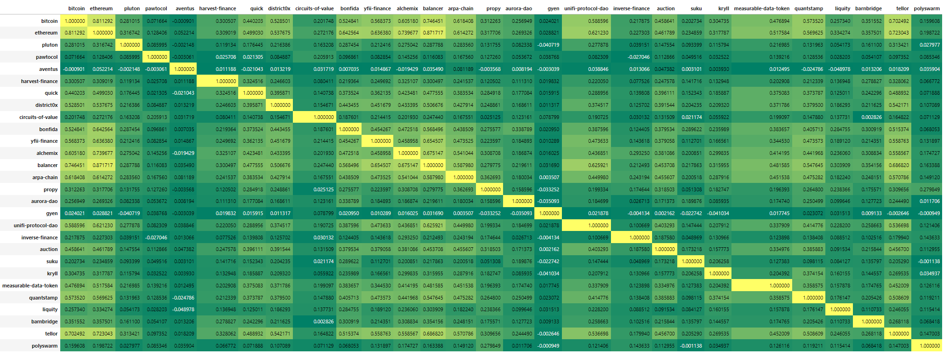
Data Analysis
Surprisingly, Bitcoin did not have the highest Sharpe Ratio. This honor went to Polyswarm. The token with the lowest Sharpe Ratio was Alchemix.
Many of these tokens outperformed both Bitcoin and Ethereum during this time sample but most had much higher risk profiles
The correlation most of these smaller cap tokens have to Bitcoin is much lower than we anticipated. From 0.02 (Gyen) to 0.81 (Ethereum), there is a significantly broader correlation than we expected.

Slide 6
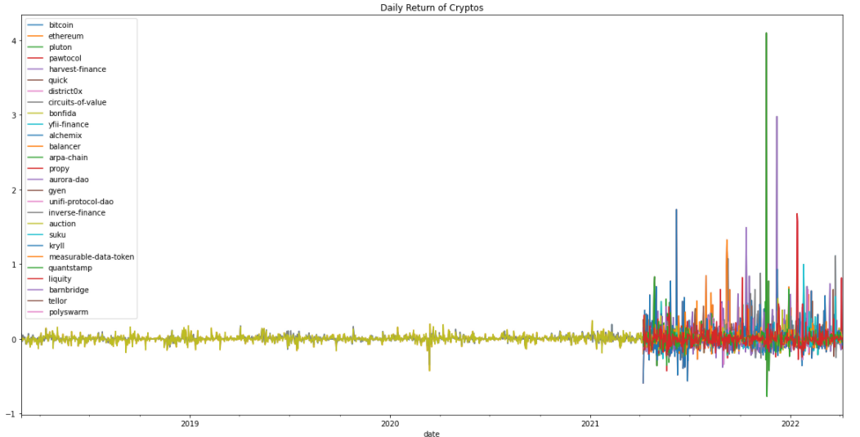
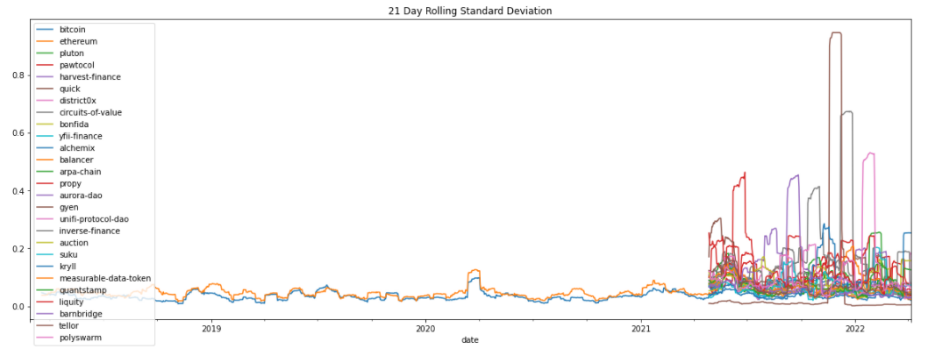
Discussion
Combing through crypto data is much more difficult than stock data. Some of these actually doubled during a single day, which is something that doesn’t happen in traditional markets.
Standard deviations of the smaller tokens were multitudes higher than those of Bitcoin and Ethereum. BTC and ETH are still considered very volatile assets, which means the other tokens were considered are SIGNIFICANTLY riskier.

Slide 7
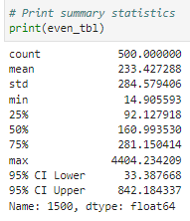
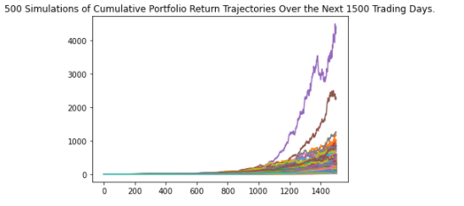
Monte Carlo Simulation Results
After reviewing our Monte Carlo Simulation results, we determined there are two likely scenarios.
We do not have enough data. Considering the mean return over 1500 days is 233x, this is an almost 6.5% daily return.
We should all put as much money as we can into this portfolio allocation.
While we wish the correct answer were scenario #2, we are 99.99% sure it’s scenario #1.

Slide 8
Postmortem
Ultimately, there is simply not enough data for us to properly answer all of our questions. Considering there are now almost 19,000 cryptocurrencies with thousands being created each year.
We would like to have had some kind of random function that chose a certain random token from a list and compared that to a BTC/ETH portfolio.
We also would have liked if there were more data (including data from a bear market).
Ultimately, there is much more we can do with this data by further manipulation or additions during future projects.

Slide 9
Questions
# Open-floor Q&A with the audience

Slide 10
Larger Data Visualizations

Slide 13
Correlations

